Slide 1
第6-2章: Class Comparison
Statistical test
Parametric empirical Bayesian method
Gene set enrichment analysis (GSEA)

Slide 2
Class comparison
What genes are up regulated between control and test or multiple test conditions
Normal vs tumor
Treated vs untreated
Fold change
Not sufficient, need statistics
Statistics
t test, non-parametric, fdr
Depends on underlying assumptions about data

Slide 3
Class Comparison
What genes are up regulated between control and test or multiple test conditions
Many analysis methods
May produce different results
Different underlying statistics and methods
t test
SAM
Non parametric (relative entropy)
Emperical bayesian
Depends on underlying assumptions about data

Slide 4
Hypothesis Testing
Normal
Tumor
d
mean1
mean2
Null hypothesis
Alternative hypotheses

Slide 5
Type I and Type II Error
 | Retain Null Reject Null
H₀ | type I error
H₁ | type II error

Slide 6
Two-Sample t-Statistic
Student’s t-statistic (equal variance)
Student’s t-statistic (unequal variance)

Slide 7
Multiple Test Problem
Perform a test for each gene to determine the statistical significance of differential expression for that gene.
Problem: When many hypotheses are tested, the probability of a type I error (false positive) increases sharply with the number of hypotheses.

Slide 8
Example
Suppose we measure the expression of 10,000 genes in a microarray experiment.
p <= 0.05 says that 95% confidence means are different; therefore 5% due to chance
500 genes are picked up by chance
Suppose t tests selects 1000 genes at a p of 0.05
500/1000 ;Approximately 50% of the genes will be false, very high false discovery rate; need more confidence

Slide 9
Corrections for Multiple Comparisons
Involve corrections to the p-value so that the actual p-value is higher
Bonferroni correction
Benjamin-Hochberg procedure
Significance Analysis of Microarrays
Tusher et al. at Stanford

Slide 10
The Bonferroni Method
Controls the family wise error rate (FWER) FWER is the probability that at least one false positive error will be made.
But this method is very conservative, as it tries to make it unlikely that even one false rejection is made.

Slide 11
False Discovery Rate (FDR)
The FDR is essentially the expectation of the proportion of false positives among the identified differentially expressed genes.

Slide 12
False Discovery Rate

Slide 13
Benjamini-Hochberg (BH) Procedure
Controls the FDR at level α when the P-values following
the null distribution are independent and uniformly distributed.
(1) Let be the observed P-values.
(2) Calculate
(3) If exists then reject null hypotheses corresponding to
. Otherwise, reject nothing.

Slide 14
Example: Bonferroni and BH Tests
Suppose that 10 independent hypothesis tests are carried out
leading to the following ordered P-values:
(a) With α = 0.05, the Bonferroni test rejects any hypothesis
whose P-value is less than α / 10 = 0.005.
Thus only the first two hypotheses are rejected.
(b) For the BH test, we find the largest k such that P_{(k)} < kα / m.
Here k = 5, thus we reject the first five hypotheses.

Slide 15
Using just the B permutations of the class labels for the
gene-specific statistic T_{j} , the P-value for T_{j} = t_{j} is assessed as:
where is the null version of t_{j} after the bth permutation
of the class labels.

Slide 16
Permutation Test
The null distribution of statistic
Generally one can permute the sample label, and calculate the statistic. And repeat such a procedure B times
If we perform B permutations, then the P-value will be estimated with a resolution of 1/B.

Slide 17
Hierarchical Bayesian Model Parametric empirical Bayes methods
Ref： C. M. Kendziorski, M. A. Newton, H. Lan and M. N. Gould. On parametric empirical Bayes methods for comparing multiple groups using replicated gene expression profiles. Statist. Med. 22:3899-3914, 2003.

Slide 18
Hierarchical Bayesian Model
Bayesian method treat genes as arising from some population, which allow a level of information sharing among genes. So it significantly reduce the dimensionality
The hierarchical model can captures differences among genes in their average expression level, differential expression for a given genes among several cell types, and measurement fluctuations.

Slide 19
Hierarchical Bayesian Model
Data: Replicate expression profiles in multiple conditions.
Objective: Find the differentially expressed genes
Method: posterior odds ratio of differential expression

Slide 20
General Mixture Model
Suppose in the general case that m + 1 distinct patterns of expression are possible for a data vector measuring a gene g in N conditions.
For any pattern k, N experiment conditions are partitioned into r(k) mutually exclusive and exhaustive subsets
Any measurements contained in a subset S_{i,k} share a common latent mean level of expression

Slide 21
General Mixture Model
Null hypothesis: all data share the same mean expression level, with distribution
Alternative model: for pattern k, its distribution
Distribution of data is given by a mixture model

Slide 22
General Mixture Model
Posterior probability of expression pattern k
Posterior odds

Slide 23
Hierarchical Bayesian Model
For replicates sharing a common latent mean expression level arise independently and identically from
The latent mean can fluctuate among genes with a genome-wide distribution
By integrating out the latent variable, we have

Slide 24
Gamma-Gamma Model
Gamma distribution with shape parameter a and scale parameter
Mean:
Variance:

Slide 25
Gamma-Gamma Model
Match to the Gamma distribution, we take inverse-Gamma distribution. More precisely, fixing , the quantity has a Gamma distribution with shape parameter and scale parameter v.

Slide 26
Gamma-Gamma Model
Then the distribution is

Slide 27
Inference
Posterior odds for two groups

Slide 28
Empirical Bayesian
The “empirical” means the small number of unknown parameters are estimated from the data
Three parameters are estimated by a S-Plus program nlminb.

Slide 29
Gamma Distribution on Wiki
In life test, the waiting time until death is generally model as Gamma distribution
Density function (shape , scale )
Expectation:
Gamma distribution is the conjugate prior for many distributions
http://en.wikipedia.org/wiki/Gamma_distribution

Slide 30
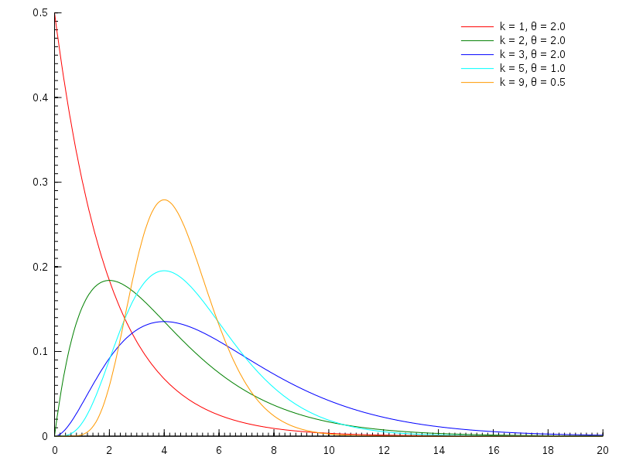
Gamma Distribution on Wiki
http://en.wikipedia.org/wiki/Gamma_distribution

Slide 31
Inverse-Gamma Distribution on Wiki
Density function
E(1/X)=a/b
If X~Inv-Gamma(a,b), kX~Inv-Gamma(a,kb)
If X~Gamma(a,b), 1/X~Inv-Gamma(a,b)
If X~Gamma(k,t), 1/X~Inv-Gamma(k,1/t)
http://en.wikipedia.org/wiki/Inverse-gamma_distribution

Slide 32
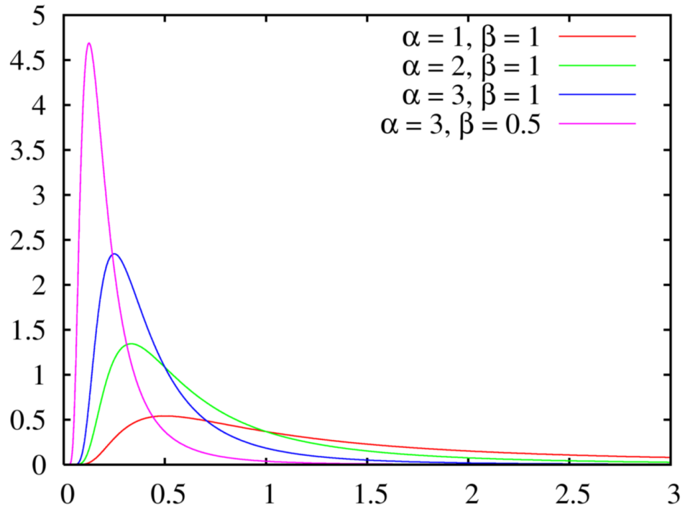
Inverse-Gamma Distribution on Wiki
http://en.wikipedia.org/wiki/Inverse-gamma_distribution

Slide 33
Gene Set Enrichment Analysis (GSEA)
References:
Subramanian et al. PNAS 102:15546, 2005.
Tian et al. PNAS 102:13544, 2005.
Mootha et al. Nature Genetics 2003

Slide 34
Motivation
Interpreting the results to gain insights into biological mechanisms remains a major challenge;
For a typical study (e.g., experimental condition vs. control, disease state vs. normal, tumor type A vs. tumor type B), a standard approach has been to produce a list of differentially expressed genes (DEGs);

Slide 35
Challenges in Interpreting Gene Microarray Data
May obtain a long list of statistically significant genes without any obvious unifying biological theme;
Even with DEG list(s) of up and/or down-regulated genes, still need to accurately extract valid biological inferences. Cutoff for inclusion in DEG lists is somewhat arbitrary. Must address multiple hypothesis testing.

Slide 36
An Existing Way to Study Enrichment of Gene Categories
Statistical procedures such as Fisher’s exact test based on the hypergeometric distribution are used to test if members of a list of differentially expressed genes are overrepresented in given GO categories or in predefined gene sets compared with the distribution of the whole set of genes represented on the chip.
Tools developed along this line include:
GOMINER;
GENMAPP;
ONTO-TOOLs;
CHIPINFO;
GOSTAT.

Slide 37
Limitation of Above Methods
No further use made of information contained in expression values for the non-DEG list genes
The level of differential expression of the genes in the significant gene list is not taken into consideration.
The correlation structure of the expression data is not considered at all.

Slide 38
Introduction of GSEA
First explored in Mootha’s Nature Genetics (03) paper, fully formulated in PNAS(05) paper.
GSEA: evaluate microarray data at the level of gene sets, which is defined based on prior knowledge (such as gene sets from GO categories or pathways from KEGG).

Slide 39
Overview of GSEA
Given a prior defined gene set S , GSEA is to determine whether members of S are randomly distributed throughout the list, or primarily found at the top or bottom in the list.
Step of GSEA:
Calculation of an enrichment score (ES).
Estimation of significance level of ES.
Adjustment for MHT.

Slide 40
Calculation of ES
Notation: D is the expression dataset with N genes and k samples; C is a phenotype or profile of interest; N_{H} is gene number of S,
Rank order N genes to form L={ g₁,☹, g_{N}} according their correlation r(g_{j})=r_{j}.
Define:
Where p is a constant to control the weight of ranks.

Slide 41
Calculation of ES
The ES is the maximum deviation from zero of P_{hit}-P_{miss}.
For a randomly distributed S, ES(S) will be small, but if it is concentrated at the top or bottom of the list, the score will be high.
When p=0, this reduces to the standard Kolmogorov-Smirnov statistic.
As P_{hit} is the empirical distribution for genes in S, while P_{miss} is the one for genes outside S.

Slide 42
GSEA Overview

Slide 43
Effect of Weight p.

Slide 44
Estimating Significance
Randomly assign the original phenotype labels to samples, reorder genes, re-compute ES(S).
Repeat for 1000 permutations, and create a histogram of the corresponding ES_{NULL};
Estimate nominal p-value for S from ES_{NULL} and observed ES(S).

Slide 45
Multiple Hypothesis Test (MHT)
Determine ES(S) for each gene set in database
For each S and 1000 fixed permutations π of the phenotype labels re-order the genes in L and determine ES(S,π).

Slide 46
Multiple Hypothesis Test (MHT)
Normalize the ES(S,π) and observed ES(S), yields the normalized scores NES(S,π), NES(S).
Compute FDR, for a given NES(S)=NES* 0.

Slide 47
Results on p53 status in NCl-60 cell lines
Enriched in p53 mutant
Ras signaling pathway 0.171
Enriched in p53 wild type
Hypoxia and p53 in the cardiovascular system 0.001
Stress induction of HSP regulation 0.001
p53 signaling pathway 0.001
p53 up-regulated genes 0.013
Radiation sensitivity genes 0.078

